Slide 1
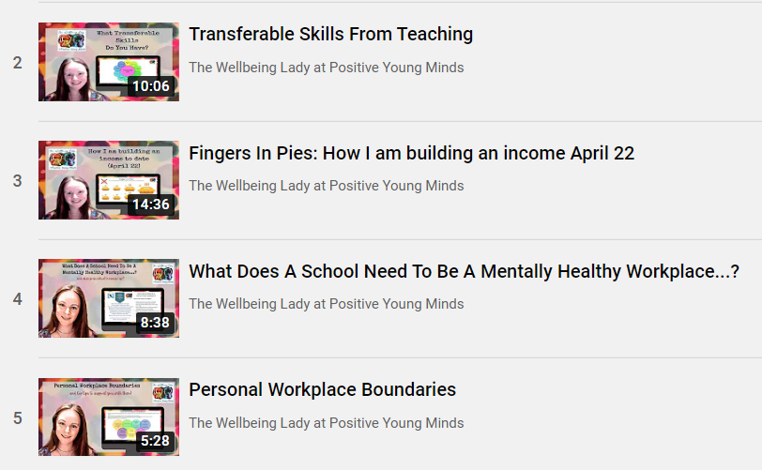
Services include:
Life, career and everything Coaching.
Bespoke school wellbeing packages.
Bespoke SEND support and training for schools teachers and parents (SEND support @PYM).
Please refer to my website for details.
I hope you liked this free resource!
Find me at:
www.positiveyoungmind.com
Email: positiveyoungminds@outlook.com
@Positive_Y_Mind (Twitter)
Positive_young_minds (Instagram)
www.facebook.com/PositiveYoungMind
…. and for free teacher support
www.facebook.com/groups/coachingforteacherwellbeing
… also like and subscribe to my YouTube (example clips above)
https://www.youtube.com/channel/UC9egtRvu5XTiwKPPqLQ-VgQ
Or just PM me ☺
Lynn How
MA NASENCO NPQH
Educational Consultant
Support options include:
Life, career and everything coaching.
Bespoke school wellbeing packages.
Bespoke SEND support and training for schools teachers and parents
Please refer to my website for details: https://positiveyoungmind.com/send-wellbeing-consultancy/

Slide 2
One Planning Graduated Approach Guide
- Children to have a One Page Profile.
- Taught in class by teacher and LSA with little / no specific SEND intervention.
- Scaffolding as part of high quality teaching expectations.
NEXT STEP: Class teacher concern form, SENCO involvement.
- One Page Profile (OPP) reviewed.
- Extra provision such as small group work is identified (with provision map).
- Informal discussions with class teacher.
NEXT STEP: Further assessments within school and possible request for specialist teacher support.
- External agencies or LA representative provides recommendations.
- Recommendations implemented in school.
- One plan produced after discussion with parents and students.
NEXT STEP: Further external specialist advice. Possible application for EHCP
(Education, Health and Care Plan).
- EHCP (Education, Health and Care Plan) granted.
- School implements recommendations.
- Annual review to review provision and yearly targets.
NEXT STEP: Further external advice, possible amendments to EHCP.
Children’s SEND provision can be reduced if progress is sustained, without needing specialist support or specific interventions. Provision and progress are reviewed regularly.

