Slide 1
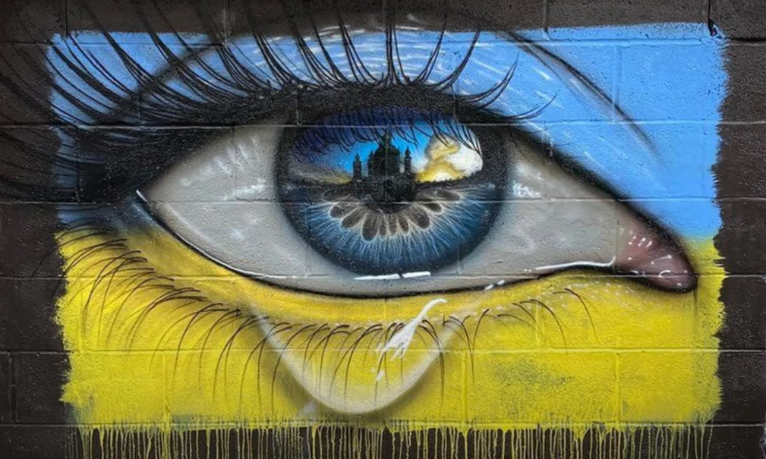
https://www.youtube.com/watch?v=auwgDr2BA7E
Notes:
A LITTLE BIT OF LOVE
https://www.youtube.com/watch?v=auwgDr2BA7E

Slide 2
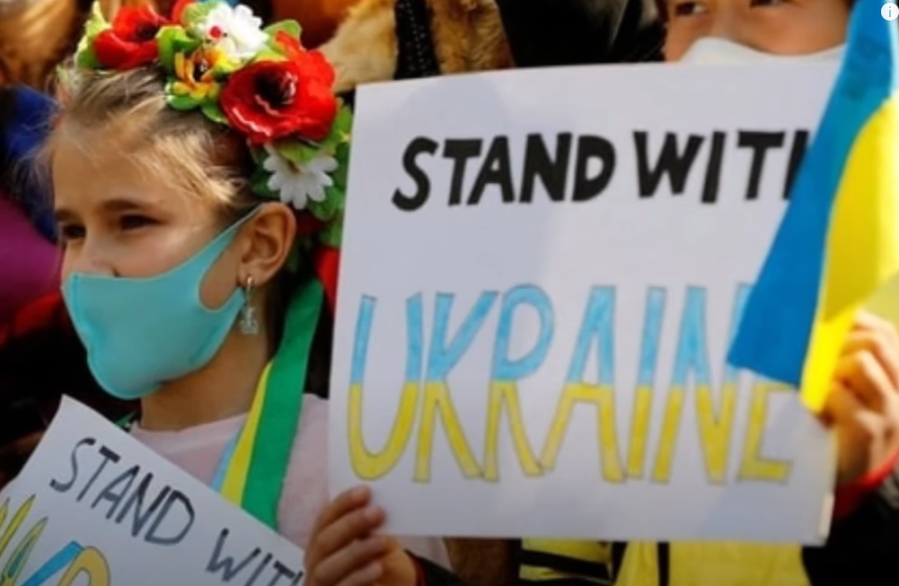
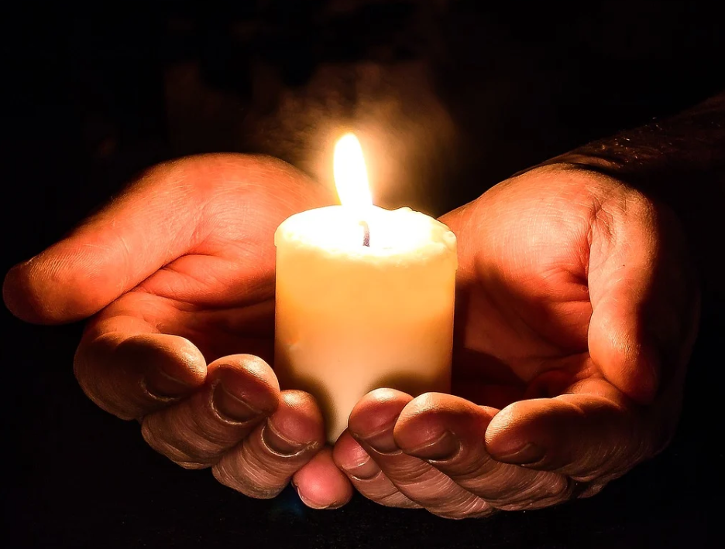
A ‘National Day of Reflection’ will take place in the UK on 23rd March.
This date marks the second anniversary since the UK was put into its first lockdown.
It is to remember those who have been lost during the pandemic.
At midday on the day of reflection, there will be a minute's silence.
Later, at 8 p.m., people are invited to create a ‘beacon of remembrance’. They can stand outside with a candle, torch or phone, or place a light in a window for others to see.
Across Britain, prominent buildings will also be lit up to mark the event.

Slide 3
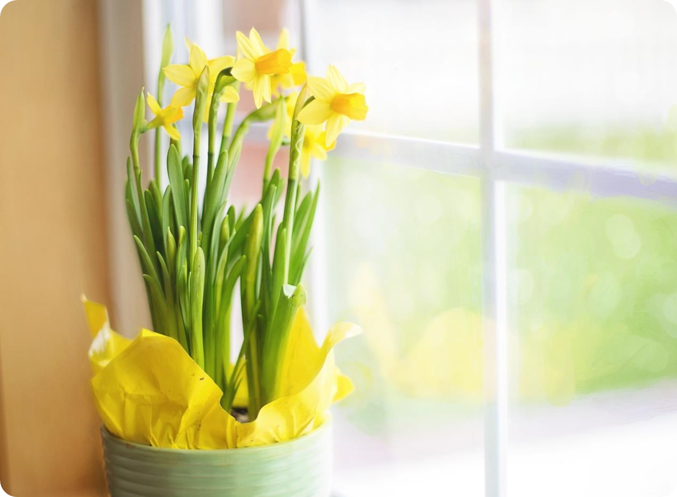
The charity leading the ‘National Day of Reflection’, Marie Curie, are encouraging people to join in by creating colourful posters and displaying them in their windows.
People are invited to draw, paint and create their own art for display.
They also suggest that some people might like to display yellow flowers or send some to someone else to show that you are thinking of them.
Some people will also be wrapping yellow ribbons around trees as their way of showing remembrance.
You might like to reflect on your own experiences during the last year and write some of them down.

Slide 4
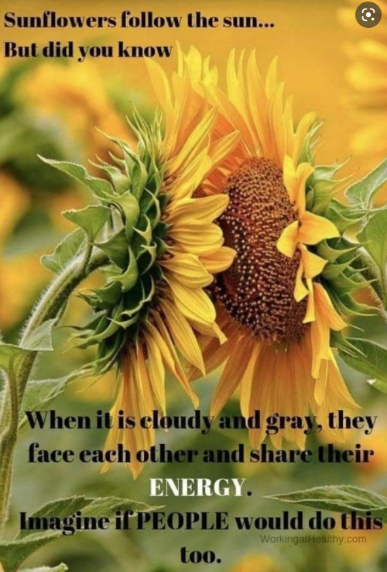
This year, we are going to merge the National Day of Reflection with a fundraiser to show our support for the people of Ukraine. We are going to raise funds for UNICEF who are helping the children of Ukraine.
Come to school in your blue and yellow colours for a donation towards UNICEF.
We will be planting sunflowers alongside our daffodils this year.
Be someone’s sunflower this week.
Stand with
Ukraine https://youtu.be/UetD59u0pI4
Notes:
ZOMBIE: https://youtu.be/UetD59u0pI4

Slide 5
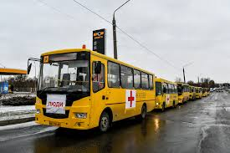
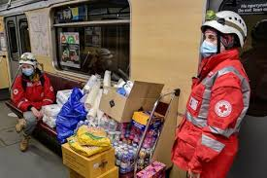
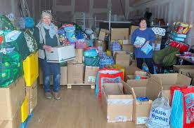
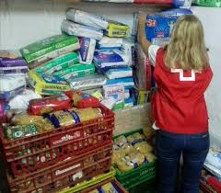

Slide 6
As well as reflecting on the grief of the past year, the National Day of Reflection is also about hoping for a brighter future. We will plant daffodils and sow sunflower seeds in the hope of beautiful blooms in months to come.
Flowers like daffodils, tulips and crocuses begin to pop up when winter ends. They’re a symbol of spring, new beginnings and of hope for better times to come.
Use today to reach out and tell someone you are thinking of them. You could create a special card to send to a friend, family member, neighbour or teacher to tell them they’re thinking of them. Or you could send cards to residents in a local care home.

Slide 7
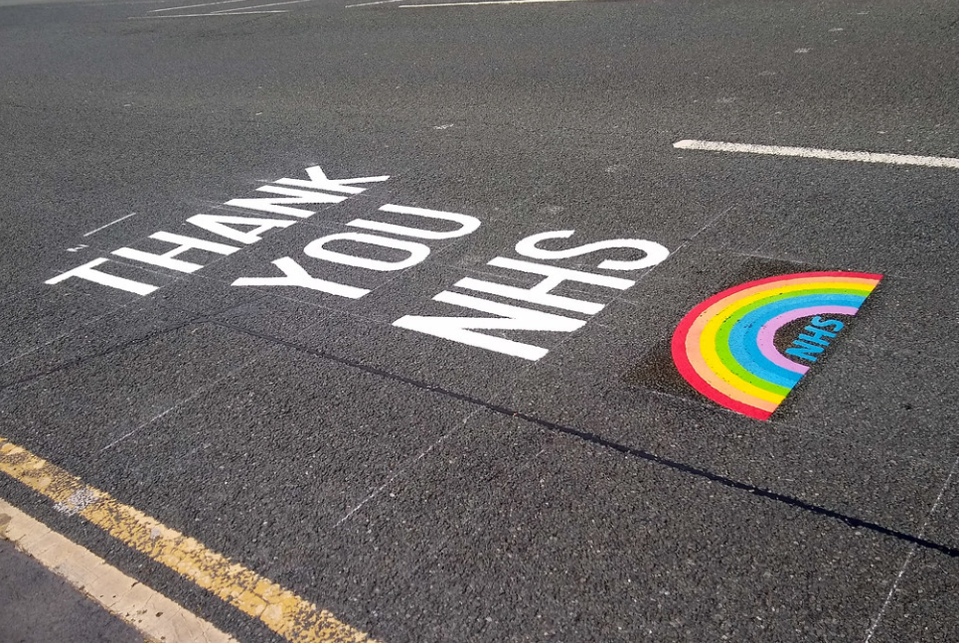
Notes:
A LITTLE BIT OF LOVE
https://www.youtube.com/watch?v=auwgDr2BA7E

