Slide 1
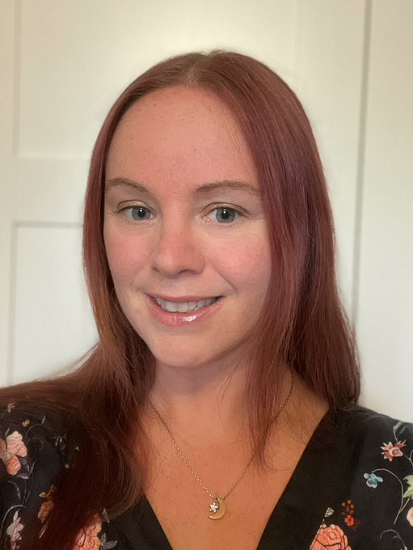
Thank you so much for downloading this resource and feel free to delete this page!
I’m Lynn author of www.positiveyoundmind.com blog for social and emotional health for children and teachers. All of my resources will always be free so please check them out!
This year I am going self-employed (yay) and will be supporting schools with their wellbeing needs as well as parents for their SEND provision needs as I’m an ex SENCO. Also have a publishing deal for 2 books on SENCOing and SEMH in the early years which is exiting! If I can help parents/schools with anything, the first 30 (ish) minute phone call will always be no obligation and will always be free. I love pointing people in the right direction when it comes to wellbeing and SEND! Please get in touch!
I would love to find out how you are finding the journal. If you have any feedback, please comment on the page where this was downloaded from or email me: positiveyoungminds@outlook.com
Happy Journaling!
From Lynn ☺

Slide 2
My Journal by _________
This is me

Slide 3
Hints and Tips for this PowerPoint:
So this should be an enjoyable process! Hopefully by using a PowerPoint you will find it easier than writing it in a book. You can also use accessibility add ons such as speech to text if you’re not keen to type! The point is getting your feelings down – it doesn’t matter how you do it! Also you can of course design your own PowerPoint if you’re not keen on this one.
Parents – take a look at: https://blogs.microsoft.com/accessibility/inclusive-remote-learning/ for accessibility ideas.
Journaling helps you grow as a person and reflect on things that might be difficult. At the same time you are working on academic skills (but that’s not the important thing here!). You might just find that you are an author in the making if it sparks your interest!
For the photo sections you might like to ask an adult to help put
pictures into a folder for you to access. Or you might know how to
find them yourself.
If you see a page you like, you can duplicate it by going to
‘insert new slide’.
Right click on pictures and select ‘change picture’.

Slide 4
The point of journaling:
To help you deal with big feelings - a private journal can be a safe place to write down those feelings. If you wish to keep your journal private and it’s a shared computer, speak to an adult about password protecting it or make it clear that it is private. Or, you may wish to discuss what you have written with an adult as sometimes it can be easier to talk about big feelings with written prompts.
You can build on your writing skills – although we don’t care about grammar and punctuation too much here. It’s more about creativity and reflection. The spell check is on hand though if required!
Write what you like – you might want to write a letter to someone (and probably not send it!) or record observations or questions. The list is endless. You can use the prompts provided or make up your own pages. Up to you!
The more you journal, the more you find it easier to process ‘stuff’. I used to write conversations to myself as a teenager and you know what? I always gave myself great advice! Once I got the hang of it, it was easier to do this ‘in the moment’ and I didn’t always have to write it all down.
Happy Journaling!
From Lynn ☺

Slide 5
All about me:
Name:
Age:
Hair colour:
Eye colour:
Height:
I am good at:
Favourite colour:
Best TV shows:
Best foods:
Favourite subjects:
Best music:
Favourite animals:
Special qualities:
Add in your own ideas!

Slide 6
My Family
This is my family they….
Notes:
NOTE: To change images on this slide, select a picture and delete it. Then click the Insert Picture icon in the placeholder to insert your own image.

Slide 7
My Friends are…..
Caption
Caption
Notes:
NOTE: To change images on this slide, select a picture and delete it. Then click the Insert Picture icon in the placeholder to insert your own image.

Slide 8
Things I love to do….
Caption
Notes:
NOTE: To change images on this slide, select a picture and delete it. Then click the Insert Picture icon in the placeholder to insert your own image.

Slide 9
Five pictures I love!
Notes:
NOTE: To change images on this slide, select a picture and delete it. Then click the Insert Picture icon in the placeholder to insert your own image.

Slide 10
Main Journal
By _____________

Slide 11
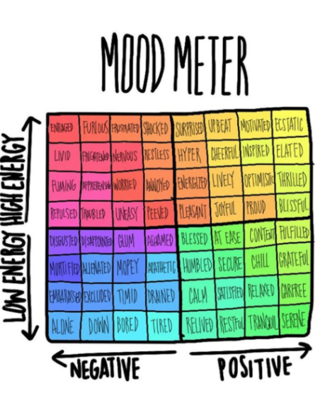
How are you feeling today?
If you’re not in the positive section, how could you get back to it?
Check out the mood meter!
You could print it if it would be helpful.
The mood meter is from this website: https://www.gopaintlove.org/mood-meter

Slide 12
What are your best qualities? I’m sure there are loads!
Record some of them here:
The qualities in me
I am kind
I am a good friend
I am funny
I am helpful
Tip – to add boxes, click on the mind map then click SmartArt tools, then add shape.

Slide 13
Let’s get active!
Exercise is great for a positive mindset! What activities do you like doing?
Or what would you like to try?
Can you find a picture from the internet of a sport you like or a picture of you doing sport?

Slide 14
If something makes you ‘wobble’, what can you do to help with that?
Find my safe space
Deep breaths and count to 10
Take yourself away from the situation
Add in your own and delete mine if you don’t like them!
Tip – to add boxes, click on the mind map then click SmartArt tools, then add shape.

Slide 15
Things bothering me at the moment
I am finding ___ really hard at school
My brother because…
Date:
(you may want to duplicate this slide and do this every week!)
Tip – to add circles, click on the mind map then click SmartArt tools, then add shape.

Slide 16
What can I do about the things that are bothering me? Maybe an adult could help with ideas.
Orange circle:
Yellow circle:
Lime green circle:
Grass green circle:
Turquoise circle:
Blue circle:

Slide 17
Being a good friend
We all have friendship issues, even adults! Sometimes people look very confident about making friends even when they are not! When you are growing up, friendships change a lot and sometimes these changes can be hard.
What do you do to make you a good friend? ….
How do you make up after an argument? ……
Is there anything about being a good friend you’d like to get better at?
What about saying sorry? Is it easy or hard for you?
Sometimes others find it hard to say sorry. Sometimes you both have to say sorry! Can you think of a time when this was a challenge?

Slide 18
Being lonely
It can be lonely sometimes. It’s common for everyone to feel it at some point!
Make a plan – you could try: Saying hi to someone new or ask them to play, join a new club in or out of school, smile be friendly and ask other people questions about themselves.
What is your plan in this situation?

Slide 19
If someone is being nasty to you….
We all have a duty to be polite and sometimes people forget this. Especially younger people who don’t understand the effect of their words and actions on others.
If this is happening to you, practise some phrases in front of the mirror that you could say.
Here are some examples:
Thank you for your opinion.
If you haven’t got something nice to say don’t speak.
Thank you for stating the obvious.
I don’t appreciate your tone.
I don’t respond to rudeness. Try again when you can be polite.
There are so many things I could say to that comment. But I won’t.
What are your ideas for this situation?
Please ask for support from a friend and/or adult if this is becoming a
problem because it is not right and you should not have to put up with it.

Slide 20
When you don’t get on….
We all have people that we don’t ‘gel’ with. This can be hard when you’re in school as this person can be with you a lot.
Either way, we need to develop strategies in managing these people! There’s no rules saying you have to like everyone, but we do need to work on our responses when we are wound up (adults as well!).
What is your plan in this situation?

Slide 21
If you are worried about someone….
If there is a friend that you are worried about then don’t stay silent.
They might be very unhappy or tired all the time or in trouble a lot, be moody or have changes in their appetite. Sometimes they may say they do not want help.
What would you suggest to them in this situation? Maybe you could write them a letter?
Dear _____
If you are worried, you may need to ask an adult to help and check everything is ok.

Slide 22
Many of us have different faces that we show to the world or keep to ourselves. What are yours?
I show the world:
I keep to myself:
As you get more confident, you are more likely to show your true authentic self. Reflect on what things you hide that you would like to show people. Perhaps you could try something small tomorrow!

Slide 23
If you do want to talk to someone about anything…
It can be hard to start difficult conversations but as the saying goes, a problem shared is a problem halved (or at least reduced slightly). A trusted adult with extra years of wisdom can probably think of solutions that you haven’t yet. They may even understand the situation a tiny bit.
I have found that it is easier to write down a script to start me off as then I can just read it.
If this would help you, you can start it off here. Here are some possible starters. Delete the ones you don’t want!
Have you got a few minutes to hear about something I’m struggling with?
This is going to sound weird but….
I’m trusting you with something really important, can you listen a minute?

Slide 24
scientists have discovered that mindfulness techniques help improve physical health in a number of ways. Mindfulness can: help relieve worry, improve sleep, improve stomach issues, go some way to preventing illness that may be stress related.
Mindfulness activities to try:
Staring at clouds or treetops – just laying on the ground watching the clouds go by and listening to the wind rustling the leaves.
Painting without thinking – just a brush, paper and colour. No need to think about it just go where the mood takes you whether its swirls or stripes. There’s no pressure to produce a masterpiece, just get the paint on the page without thinking.
Sensory activities – whether it’s popping those pop toys or playing with cornflower and water mixtures, all are calming.
Glitter bottle – make one together out of a plastic water bottle. Shake it and watch it settle.
Body scan – lie down and relax every part of your body, one part at a time from your head to your feet.
For further great ideas see:
https://alderhey.nhs.uk/application/files/9815/8515/7280/Mindfulness_activities_for_kids.pdf
https://www.bbcgoodfood.com/howto/guide/10-mindfulness-exercises-kids
Which did you like? Record your opinions here:

Slide 25
Feeling sad
We all feel sad. Sometimes we can bounce back quickly, sometimes it takes longer. Journaling it great for this. If you are feeling sad for a while please discuss it with someone.
Use this space to record your thoughts:

Slide 26
Ideas for further prompts – Copy and paste the ones you would like to write about on a new page.
You are the teacher for the day. What do you do.
Put yourself in someone else’s shoes. Describe their life.
Look in the mirror and write about what you see.
Describe a situation where someone sucked your energy (a mood hoover!).
Who do admire and why?
What are your top fears? How could you make these smaller?
Write about a time you over reacted. What could you do differently?
Write about a time you helped someone. How does that make you feel?
What bad habits do you have and would you like to change them?
What personality traits do you value in others?
Write a letter to yourself planning 3 things to work on.
Check out this website for another 52 ideas!
https://www.waterford.org/resources/journal-prompts-for-kids/

