Slide 1
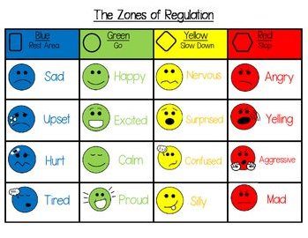
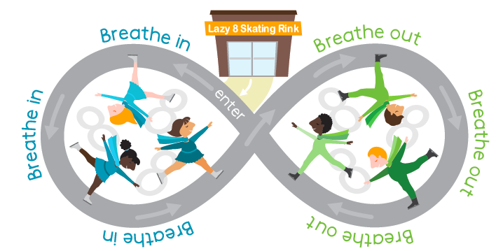
My Learning
Passport
School Logo here
Name:
Class:

Slide 2
Date | Parents comment
My Learning
Toolkit
Draw or write 4 things in class that help you learn
Which adults can help you? _________________________

Slide 3
My Learning Plan
Write down some strategies or resources from your one plan or one page profile which will support you in your learning.
__________________________________________
__________________________________________
__________________________________________
__________________________________________
__________________________________________
__________________________________________
__________________________________________
__________________________________________
Date | Pupil comment

Slide 4
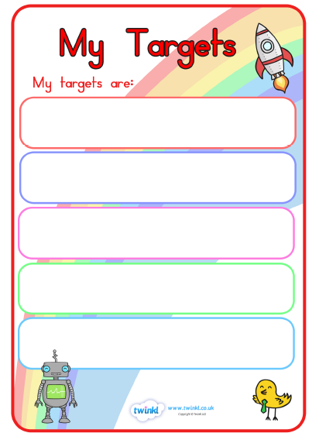
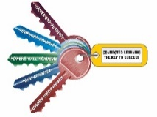
date
Achieved?
date
Achieved?

Slide 5
date
Achieved?
date
Achieved?

Slide 6
date
Achieved?
date
Achieved?

